Slide 1

Lecture 8
Basic CSS Usage: Selectors, Background and Border
Notes:
Welcome to this M1 in SQL Course. In this first chapter of the course, we are going to do an introduction of databases and relational databases.

Slide 2

A G E N D A
Simple Selectors
Combinator Selectors
CSS Background
CSS Borders

Slide 3
Simple Selectors
Notes:
Without further adieu, Let’s look at the course introduction so that you will know what you are going to learn.

Slide 4

CSS Selectors
Often times in HTML documents, we will have the same tag repeating multiple times
We will need a more specific method to select the HTML element for styling
In this chapter, we learn about how we can pinpoint HTML elements that we want to style.

Slide 5
CSS Selectors
Different types of selectors:
will be covered in this course
Simple selectors
Combinator selectors
Pseudo-class selectors
Pseudo-elements selectors
Attribute selectors
(HTML tag, class, id)
One of the most common and basic selectors.
They use classes and ids in order to pinpoint HTML elements

Slide 6
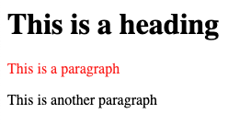
ID Selector
The ID selector pinpoints HTML elements by locating their id attribute
Two different HTML elements cannot have the same id.
HTML
<h1>This is a heading</h1>
<p id="para">This is a paragraph</p>
<p>This is another paragraph</p>
only the first <p> is styled
CSS
# is the ID selector
#para {
color: red;
}
Warning: ID Selectors should not begin with a numerical!

Slide 7
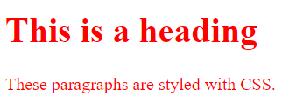
Class Selector
The class selector pinpoints HTML elements by comparing class attributes
HTML
<h1 class="para">This is a heading</h1>
<p class="para">These paragraphs are styled with CSS.</p>
CSS
. is the class selector
.para {
color: red;
}
Warning: Class Selectors should not begin with a numerical!

Slide 8
Challenge Question 1
What if we only want the <p> tag with class "para" to be styled red?
HTML
<h1 class="para">This is a heading</h1>
<p class="para">These paragraphs are styled with CSS.</p>
<p>These paragraphs is not styled with CSS.</p>

Slide 9
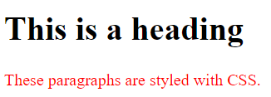
Challenge Question 1
What if we only want the <p> tag with class "para" to be styled red?
HTML
<h1 class="para">This is a heading</h1>
<p class="para">These paragraphs are styled with CSS.</p>
<p>These paragraphs is not styled with CSS.</p>
CSS
p.para {
color: red;
}
means p tag with para class

Slide 10
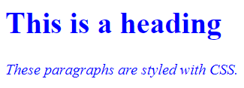
Multiple Classes
Each HTML tag can be attached to multiple classes
Multiple classes are separated by spaces.
HTML
<h1 class="para">This is a heading</h1>
<p class="para italic">These paragraphs are styled with CSS.</p>
CSS
.para {
color: blue;
}
.italic {
font-style: italic;
}
Both “blue” and “italic”

Slide 11
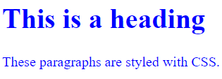
Universal Selector
The universal selector (*) pinpoints all the HTML elements defined in the body
HTML
<h1>This is a heading</h1>
<p>These paragraphs are styled with CSS.</p>
CSS
* {
color: blue;
}

Slide 12
Combinator Selectors
Notes:
Without further adieu, Let’s look at the course introduction so that you will know what you are going to learn.

Slide 13
CSS Selectors
Different types of selectors:
will be covered in this course
Simple Selectors
Combinator Selectors
Pseudo-class Selectors
Pseudo-elements Selectors
Attribute
Selectors
Uses relationship between elements to pinpoint an element in HTML

Slide 14
CSS Combinators
A combinator is something that explains the relationship between the selectors.
Four different combinators in CSS
descendant selector (space)
child selector (>)
adjacent sibling selector (+)
general sibling selector (~)

Slide 15
Descendent Selector
The descendant selector selects descendants of a particular element.
Example 1 - List
<ul>
<li>Item 1</li>
<li>Item 2</li>
<li>Item 3</li>
</ul>
Parent Element
Child Elements
Example 2 - Table
<table>
<tr>
<td>Value 1</td>
</tr>
<tr>
<td>Value 2</td>
</tr>
</table>
Parent Element
Child Elements

Slide 16
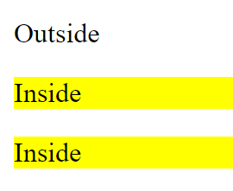
Descendent Selector
The descendant selector selects descendants of a particular element.
select p tag inside div
<p>Outside</p>
<div>
<p>Inside</p>
<section>
<p>Inside</p>
</section>
</div>
div p {
background-color: yellow;
}
CSS
HTML

Slide 17
Child Selector
The child selector matches all elements that are direct descendents of a specified element.
Example 1 - Table
<table>
<tr>
<td>Value 1</td>
</tr>
<tr>
<td>Value 2</td>
</tr>
</table>
Parent Element
Direct Child Elements
Non-direct Child Elements

Slide 18
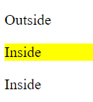
Child Selector
The child selector matches all elements that are direct descendents of a specified element.
Direct p child of div
<p>Outside</p>
<div>
<p>Inside</p>
<section>
<p>Inside</p>
</section>
</div>
div > p {
background-color: yellow;
}
CSS
HTML

Slide 19
Adjacent Sibling Selector
The adjacent sibling selector pinpoints elements that are immediately after another specified element.
Example 2 - Table
<div>
DIV
</div>
<p>P after div</p>
<p>P after div</p>
Adjacent Sibling Element of div
Non-adjacent Sibling Element div

Slide 20
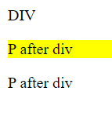
Adjacent Sibling Selector
The adjacent sibling selector pinpoints elements that are immediately after another specified element.
<div>
DIV
</div>
<p>P after div</p>
<p>P after div</p>
div + p {
background-color: yellow;
}
CSS
P tag immediately after a div
HTML

Slide 21
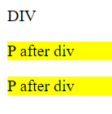
General Sibling Selector
The general sibling selector pinpoints all the possible elements that are defined after the specified element.
<div>
DIV
</div>
<p>P after div</p>
<p>P after div</p>
div ~ p {
background-color: yellow;
}
CSS
All p tags after a div
HTML

Slide 22
Background
Notes:
Without further adieu, Let’s look at the course introduction so that you will know what you are going to learn.

Slide 23
CSS Background
We have seen coloured text:
Hello World!
What about coloured background:
Hello World!

Slide 24
Background Color
<h1 style="background-color:DodgerBlue;">This is a heading</h1>
The entire space occupied by the Hello World header will have a blue background color applied to it.

Slide 25
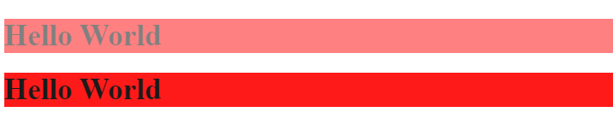
Opacity
HTML
CSS
<div class="second">
<h1>Hello World</h1>
</div>
<div class="third">
<h1>Hello World</h1>
</div>
div {
background-color: red;
}
.second {
opacity: 0.5;
}
.third {
opacity: 0.9;
}

Slide 26
Background Image
HTML
CSS
<body>
<h1>Hello World</h1>
</body>
body {
background-image: url("flower.jpg");
}

Slide 27
Border
Notes:
Without further adieu, Let’s look at the course introduction so that you will know what you are going to learn.

Slide 28
Borders Syntax
Note: Type of border can range from dotted, dashed, solid, hidden etc
h1 {
border: 2px solid Tomato;
}
2px | Width of the border
solid | Type of border
Tomato | Colour of the border
Notes:
Reference: https://www.w3schools.com/css/css_border.asp

Slide 29
Borders Syntax
CSS
HTML
h1 {
border: 2px solid Tomato;
}
<h1>Hello World</h1>

Slide 30
Fine Control of Borders
Border sides can be styled one by one using:
  border-top
  border-bottom
  border-left
  border-right
CSS
HTML
h1 {
border-bottom: 2px solid Tomato;
}
<h1>Hello World</h1>
only bottom border is styled

Slide 31
Border Radius for Rounded Corner
CSS
HTML
h1 {
border: 2px solid green;
border-radius: 10px;
}
<h1>Hello World</h1>

Slide 32

That’s all for this module!
THANK YOU!

